Slide 1
CS310 Operating Systems Lecture 14: Threads – Examples
Ravi Mittal
IIT Goa

Slide 2
Acknowledgements !
Contents of this class presentation has been taken from various sources. Thanks are due to the original content creators:
CS162, Operating System and Systems Programming, Profs. Natacha Crooks and Anthony D. Joseph, University of California, Berkeley
CS240 Computer Systems, Univ of Illinois, Prof. Wade Fagen-Ulmschneider
Operating Systems: Three Easy Pieces, by Remzi and Andrea Arpaci-Dusseau, available for free online
Book: Modern Operating Systems, Andrew Tenenbaum, and Herbert Bos, 4th Edition, Pearson

Slide 3
Reading
Book: Operating Systems: Principles and Practice: Thomas Anderson and Michael Dahlin, Part 2, Chapter 4
CS162, Operating Systems and Systems Programming, University of California, Berkeley
CS4410, Operating Systems, Course, Cornell University, Spring 2019, Lecture on Threads
Operating Systems: Three Easy Pieces, by Remzi and Andrea Arpaci-Dusseau, available for free online

Slide 4
We have learnt so far ..

Slide 5
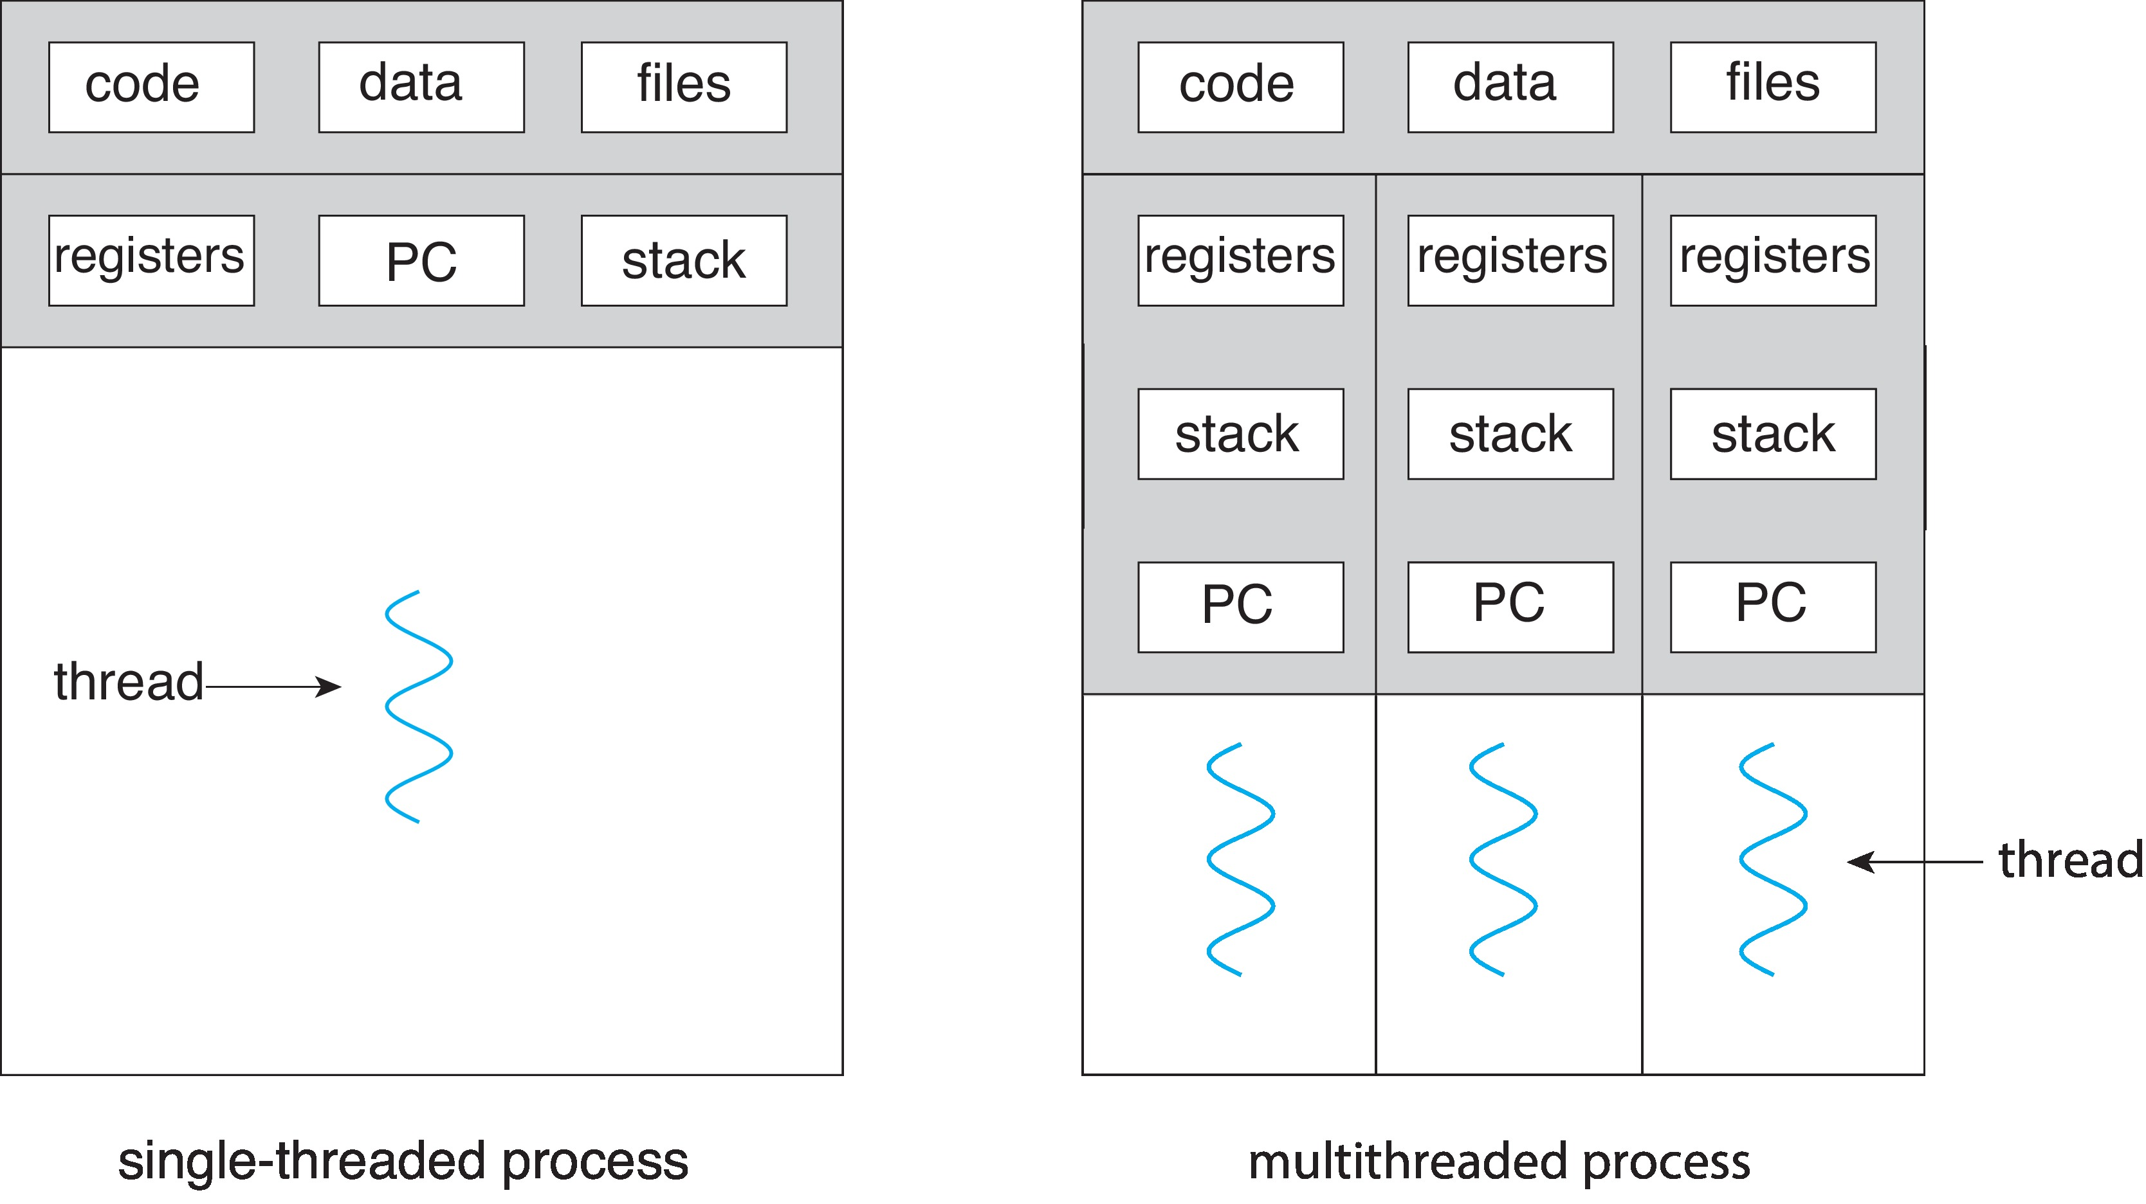
Recall: Single and Multithreaded Processes
Address
Space
Address spaces encapsulate protection: Passive Part
Threads share code, data, files, heap

Slide 6
Thread Abstraction

Slide 7
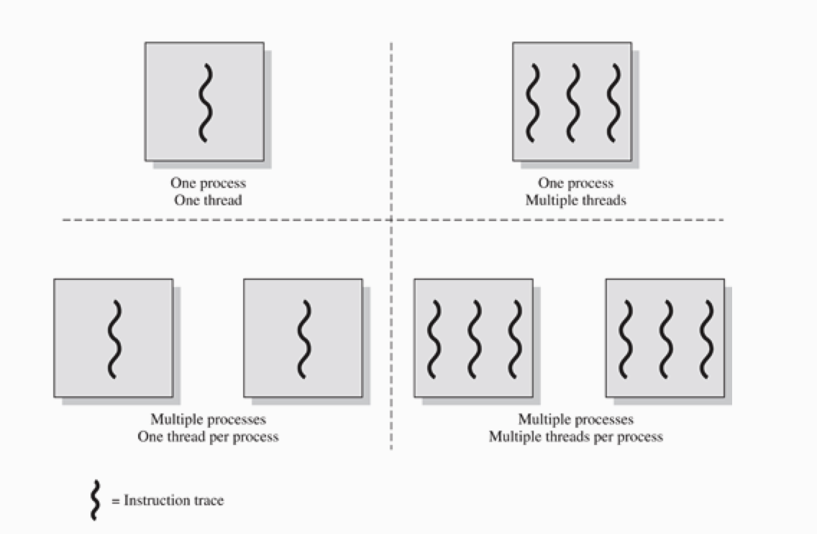
Source: OS book by Stallings

Slide 8
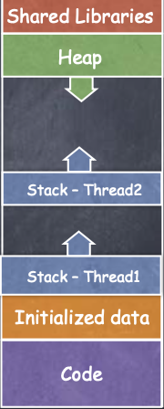
Threads
Process Address Space
All threads within a process share
Heap
Global/static data
Libraries
Each thread has a separate
Program Counter
Stack
registers
CS4410 Cornell University

Slide 9
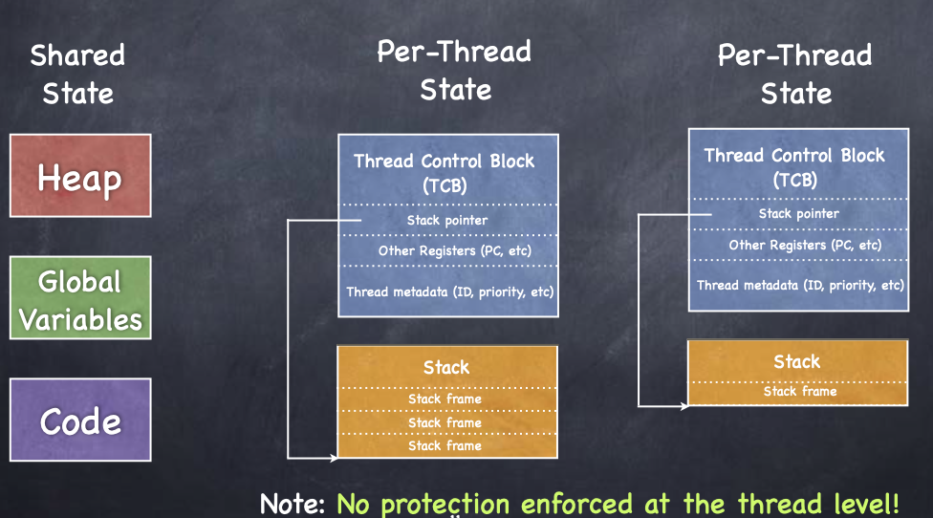
Implementing Thread Abstraction
CS4410 Cornell University

Slide 10
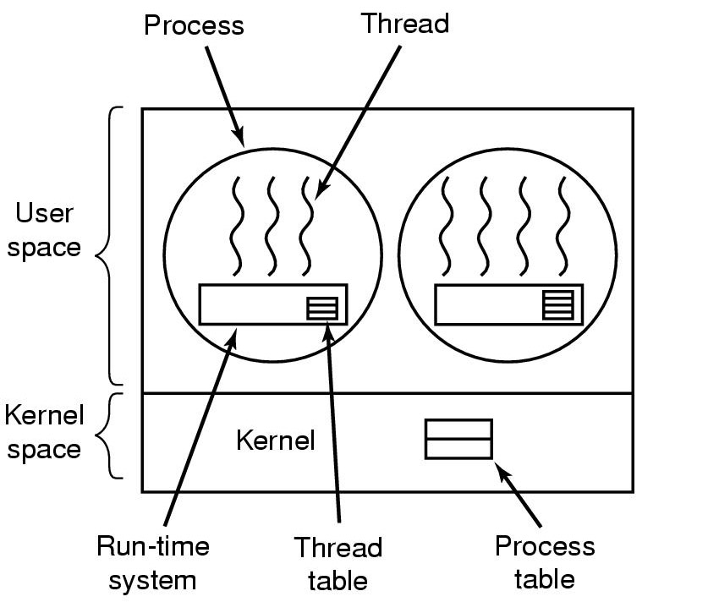
Implementing Thread in User Space (1)
Threads run on top of run-time system
Collection of procedures to manage threads
Each process needs own private thread table (Thread control Block)

Slide 11
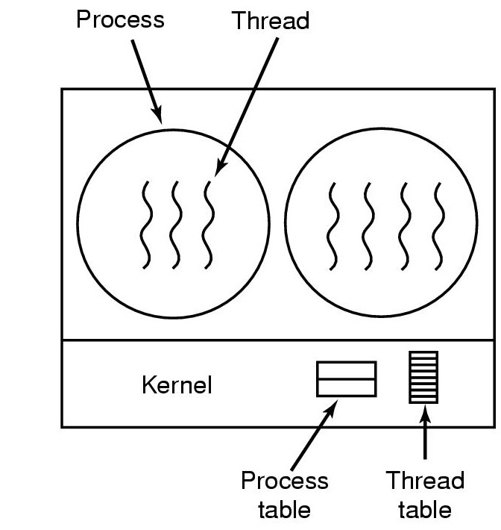
Thread Management in Kernel (1)
Kernel knows how to manage threads in a user process
No run-time system required
No thread table in each process
When a thread wants to create a new thread or destroy an existing thread, it makes a system call
Kernel creates or destroys thread as per request.
Updates kernel thread table
(PCBs)
(TCBs)

Slide 12
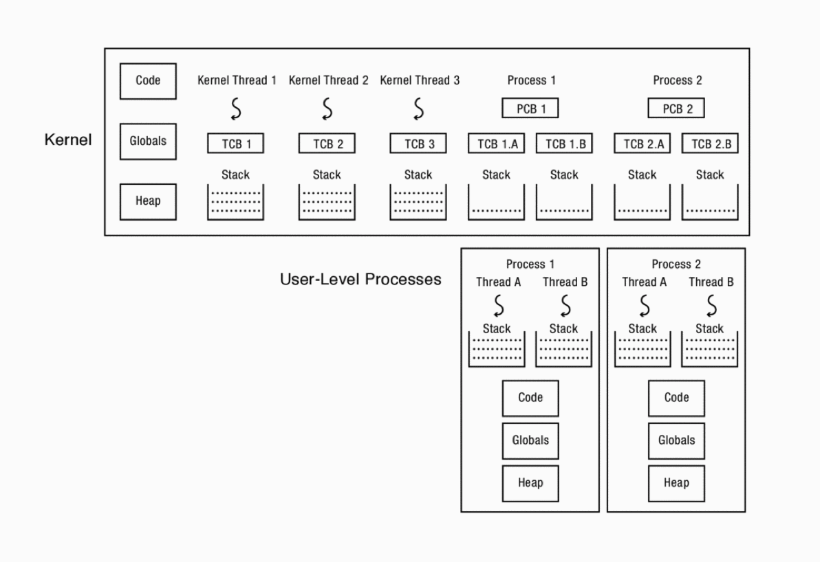
Thread Management in Kernel
Three Kernel threads and
Two user level processes – each process with two threads
Each user thread has a user stack for executing code and a Kernel (interrupt) stack executing interrupts and system calls
Thread management is done in Kernel

Slide 13
Logical View of Threads
Threads associated with a process form a pool of peers
Unlike processes, which form a tree hierarchy
Threads associated with process foo
Process hierarchy
T2
P0
T4
T1
P1
shared code, data
and kernel context
sh
sh
sh
T5
T3
foo
bar

Slide 14
Thread Libraries
Thread library provides programmer with API for creating and managing threads
Two primary ways of implementing
Library entirely in user space
All code and data structures for the library exist in user space with no kernel support
Kernel-level library supported by the OS
Code and data structures exist in Kernel Space
Invoking a function in the API for the library typically results in a system call to the kernel

Slide 15
Today we will study ..
Posix Thread library
Thread Example 1

Slide 16
Thread Libraries
Three main Thread Libraries in use today
POSIX Pthread
User or Kernel level
Windows
Kernel-level
Java
Using Windows APIs
Linux, Unix, MacOS
Pthreads

Slide 17
Thread Library: pthread

Slide 18
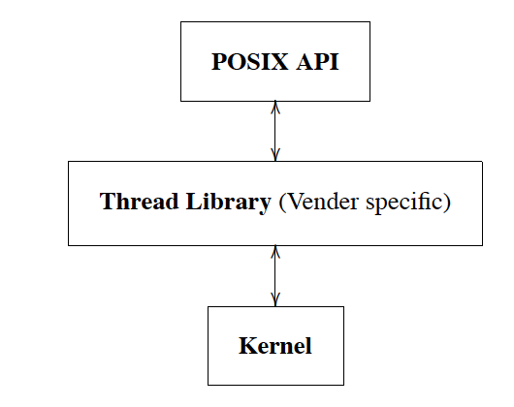
Thread Implementation: Layers of Abstraction

Slide 19
What are pthreads?
POSIX standard IEEE 1003.1c defines a thread interface
pthreads
Unix/Linux provides pthread library
APIs to create and manage threads
Implementation is up to development of the library
Simply a collection of C functions
Standard interface for ~60 functions that manipulate threads from C programs
Primary way of doing threading in Linux is pthread
Since 2003 (Kernel 2.6), Linux implements POSIX threads as kernel-scheduled threads

Slide 20
pthread APIs
Creating and reaping threads
pthread_create, pthread_join
Determining your thread ID
pthread_self
Terminating threads
pthread_cancel, pthread_exit
Synchronizing access to shared variables
pthread_mutex_init, pthread_mutex_[un]lock
pthread_cond_init, pthread_cond_[timed]wait
Notes:
Thread cancellation a thread terminate the execution of any other thread in the process. This is done by pthread_cancel()
Calling pthread_cancel is a polite request that another thread shut itself down.

Slide 21
Aside: Pointers to Functions in C (self reading)
A function can take many types of arguments including the address of another function
Instructions of a program are stored in MM locations
Instruction too have addresses
Like data
So, we can point to an individual instruction
Pointing to an individual instruction is not useful
Point to the first instruction of a function → useful
Function Pointer :
a variable or parameter that points at a function
Note that a function name is a pointer to it
Helps to initialize such variables or parameters

Slide 22
Aside: Pointers to Functions in C (self reading)
Function name is actually starting address of the code in the memory (think Computer Architecture – Machine instructions)
Start of the function code or the address of a function is a function pointer
Function pointer is different from other pointers since you do not allocate or deallocate memory with them
Function pointers can be passed as arguments to other functions or return from functions
Unfortunately function pointers have complicated syntax and therefore are not widely used

Slide 23
Aside: Pointers to Functions in C (self reading)
Provides late binding
deciding the proper function during runtime instead of compile time
Ex: Determine sorting function based on type of data at run time
Technically speaking, the name of any function is a pointer to that function
However, when we refer to a function pointer, we mean a variable or parameter that points to a function

Slide 24
Aside: Pointers to Functions in C (self reading)
int (*fn)(int,int) ;
Here we define a function pointer fn, that can be initialized to any function that takes two integer arguments and return an integer
Consider a function:
int sum(int x, int y) {
return (x+y);
}
Now to initialize fn to the address of the sum, we can do the following:
fn = &sum /* make fn points to the address of sum */
int x = (*fn)(12,10); /* call to the function through a pointer */

Slide 25
Pthread_create
int pthread_create( pthread_t *thread, /​* thread struct */
const pthread_attr_t *attr, /​* usually NULL *​/
void *(*start_routine) (void *), /​* start func */
void *arg ​ /* thread start arg */
);
This function takes 4 parameters
The first parameter is a pointer to structure of type pthread_t which describes a thread
Pthread_create function fills in this structure with information about the newly created thread
We can use type pthread_t to refer to the thread in other library calls
The thread parameter points to the thread ID of the newly created thread
The second argument lets you specify particular attribute of the thread
Usually Null. The new thread has default attributes.

Slide 26
Pthread_create
int pthread_create( pthread_t *thread, /​* thread struct */
const pthread_attr_t *attr, /​* usually NULL *​/
void *(*start_routine) (void *), /​* start func */
void *arg ​ /* thread start arg */
);
The third argument specifies the entry point to the new thread
Unlike the entire program, which starts at main, there is no pre-defined entry point for other threads
The thread that creates the new thread must specify the function in which the new thread must start
This function is specified by passing a function pointer which must have type void*(*)(void *)
A pointer to a function that takes a void* and returns a void*
Notes:
A void pointer is a pointer that has no associated data type with it. A void pointer can hold address of any type and can be typcasted to any type.
int a = 10;
char b = 'x';
void *p = &a; // void pointer holds address of int 'a'
p = &b; // void pointer holds address of char 'b'

Slide 27
Pthread_create
int pthread_create( pthread_t *thread, /​* thread struct */
const pthread_attr_t *attr, /​* usually NULL *​/
void *(*start_routine) (void *), /​* start func */
void *arg ​ /* thread start arg */
);
arg parameter specifies what to pass into this function as its arguments when the function is called on the newly spawned thread
It returns 0 on success; non-zero error code on error
The thread created by pthread create is runnable without requiring a separate start code. It begins execution on the first line of the function routine provided in the third argument.

Slide 28
Pthread_create
When pthread_create is called a few things happen ( that are different from we have seen before)
A new stack is created that is independent of caller’s stack
Frames can be created and destroyed on this stack – which is independent of frame creation and destruction on other stacks (for other threads)
The stack with a frame is created for the function requested (as the third argument) passing in the arguments
Now second execution arrow (corresponding to the current value of PC) is created at the start of the function that we specify as the entry point of the new thread
You can imagine execution arrow as a point in execution of the thread
Concurrent execution of both threads begins

Slide 29
pthreads – Completion
A Thread exits
By returning from the function it started in, or
By calling pthread_exit
It’s return value ( either what the function returned or argument passed to pthread_exit must be kept available for another thread to retrieve
pthread_join
Thread calling pthead_join waits for the specified thread to exit and obtaining the return value
When one thread calls pthread_joins - it blocks until the thread it is joining terminates
Resources associated with the thread that is ended

Slide 30
Pthread - Completion
int pthread_join(pthread_t thread, void **value_ptr);
The first argument is of type pthread_t and it specifies the thread to wait for
The second argument is a pointer to the return value you expect to get back
It ignores the return value by passing in NULL for the second argument
When one thread calls pthread_join it stops advancing – until the thread it is joining terminates
Joining a thread also allows for the pthread library to release resources associated with the thread
A zombie thread is a joinable thread which has terminated, but which hasn't been joined.

Slide 31
pthread_detach; Main terminating
Pthread-detach
A thread tells the pthread library that is will never join another thread with pthread_detach
This allows library to release resources as soon as the thread exits
The Main thread (in main function) behaves differently
If main returns, the entire process exits – thus terminating all threads inside it
Note that main was not called by pthread library. It was called by C library

Slide 32
Fork-Join Parallelism
create
exit
join
Main thread creates (forks) collection of sub-threads passing them args to work on…
… and then joins with them, collecting results
Data may be safely shared between parent and child
It is written by parent before child starts
It is written by the child and read by the parent after the join
Crooks & Joseph CS162 © UCB Spring 2021

Slide 33
Thread - Example

Slide 34
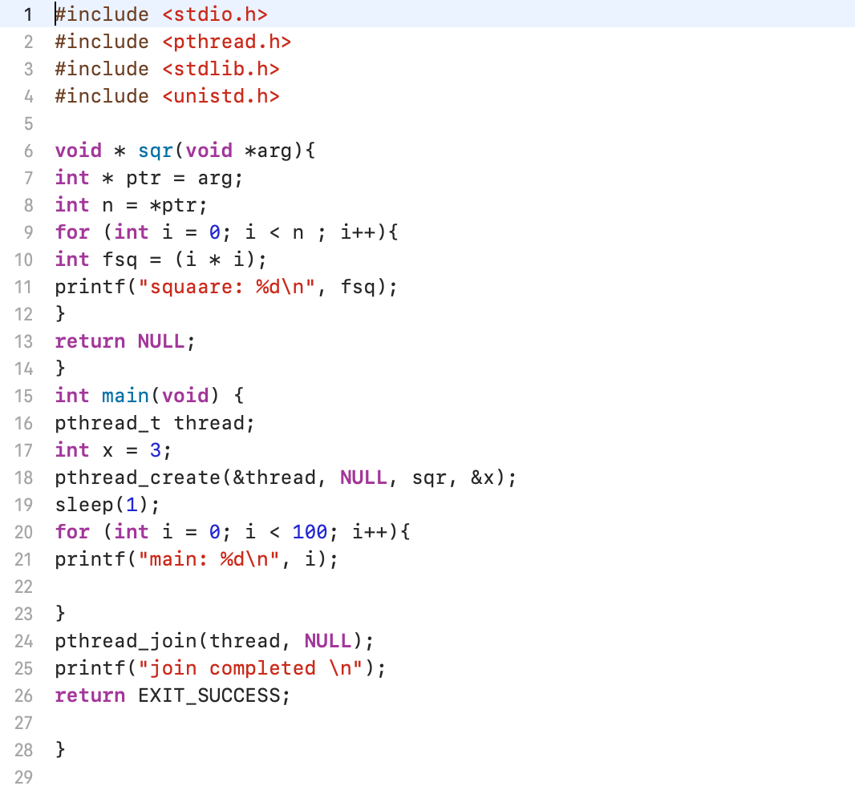
th1.c

Slide 35
th1.c
Thread 0
main

Slide 36
th1.c
Thread 0
main
Thread ?

Slide 37
th1.c
Thread 0
main
thread ?
x 3

Slide 38
th1.c
Thread 1
Thread 0
sqr
main
arg
thread 1, run
x 3

Slide 39
th1.c
Thread 1
Thread 0
sqr
main
arg
thread 1, run
x 3
output

Slide 40
th1.c
Thread 1
Thread 0
sqr
main
arg
thread 1, run
ptr
x 3
output

Slide 41
th1.c
Thread 1
Thread 0
sqr
main
arg
thread 1, run
ptr
x 3
n 3
output

Slide 42
th1.c
Thread 1
Thread 0
sqr
main
arg
thread 1, run
ptr
x 3
n 3
i 0
output

Slide 43
th1.c
Thread 1
Thread 0
sqr
main
arg
Thread 1, run
ptr
x 3
n 3
i 0
output

Slide 44
th1.c
Thread 1
Thread 0
sqr
main
arg
thread 1, run
ptr
x 3
n 3
i 0
fsq 0
output

Slide 45
th1.c
Thread 1
Thread 0
sqr
main
arg
thread 1, run
ptr
x 3
n 3
i 2
fsq 4
square 0
square 1
square 4
output

Slide 46
th1.c
Thread 0
main
thread 1, exit, NULL
x 3
thread 1 exited
square 0
square 1
square 4
output

Slide 47
th1.c
Thread 0
main
thread 1, exit, NULL
x 3
i 0
main 0
output

Slide 48
th1.c
Thread 0
main
thread 1, exit, NULL
x 3
i 99
main 0
main 1
main 99
output

Slide 49
th1.c
Thread 0
main
thread 1, exit, NULL
x 3
i 99
Thread 0 unblocks
main 0
main 1
main 99
join competed
output

Slide 50
Lecture Summary
We have used pthread library’s APIs
pthread_create
pthread_join

